Slide 1


Cybersecurity Plan for an AI-Integrated IIoT System
Subtitle: Smart Factory Case Study
Name: Win Ko Aung
Course: ITAI3377
Notes:
Speaker Notes: “Hello everyone, today I will present my cybersecurity plan for a smart factory environment integrating AI and IIoT technologies.”

Slide 2

System Overview
Content:
System: Smart Factory
Components:
Smart sensors
Robotic arms
Edge computing nodes
Cloud AI models
Dashboards
Data lake
Goal: Optimize production and predictive maintenance
Notes:
Speaker Notes: “This smart factory uses AI to predict equipment failures and adjust workflows in real time, making it a great example of Industry 4.0.”

Slide 3
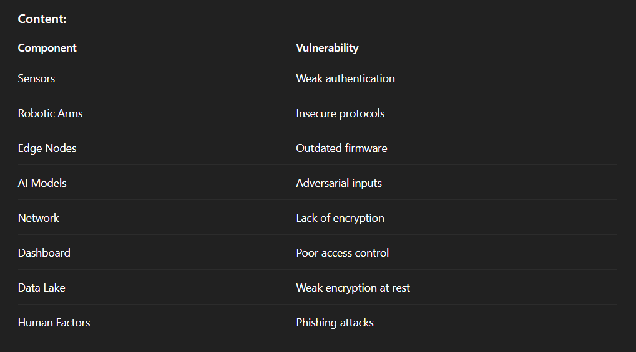
Identified Vulnerabilities
Notes:
Speaker Notes: “I assessed vulnerabilities across the entire system, from devices and network to human factors and AI models.”

Slide 4
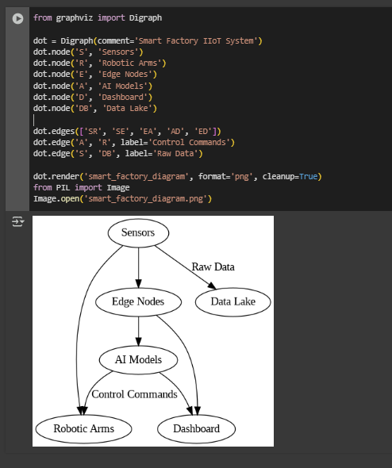
System Diagram
Notes:
Speaker Notes: “This diagram shows the components and data flows in the smart factory, highlighting the points where vulnerabilities could be exploited.”

Slide 5

Defense Strategy
Content:
Secure by Design: Harden firmware and configs
Authentication: MFA and certificates
Encryption: TLS 1.3, AES-256
Network Security: VLANs, IDS
AI Security: Input validation and monitoring
Incident Response: Real-time alerts and playbooks
Notes:
Speaker Notes: “My defense plan uses layered security measures to protect each component and data flow.”

Slide 6
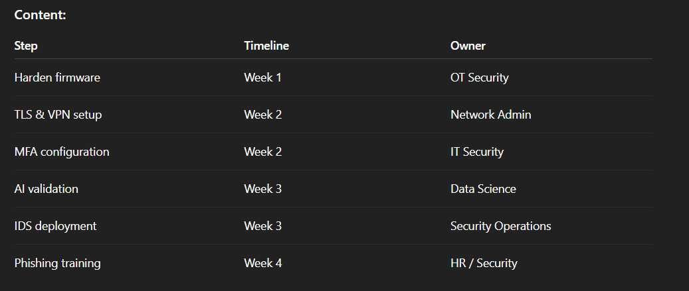
Implementation Plan

Slide 7
Penetration Testing & Results
Content:
Simulated Attacks:
Brute-force login attempts
Spoofed sensor data
MITM attacks
Results:
MFA blocked brute-force
Data validation stopped spoofing
Encryption prevented eavesdropping
Notes:
Speaker Notes: “I simulated common attack scenarios and assessed how effective the defenses were in stopping them.”

Slide 8
Reflection & Lessons Learned
Content:
Complexity requires layered defenses
Human factors are critical
Continuous monitoring is essential
Confidence in designing secure IIoT systems
Notes:
Speaker Notes: “This project taught me that security in Industry 4.0 is about balancing technology, processes, and people.”

Slide 9
Access Presenting Video
Midterm Project Presentation.mp4

Slide 10

Thank You / Q&A
Content: “Thank you for your attention. Any questions?”
Notes:
Speaker Notes: “I appreciate your time, and I’m happy to answer any questions.”

